Slide 1
Date: 18/03/26
Paper Presentation
CaliGCL: Calibrated Graph Contrastive Learning via Partitioned Similarity and Consistency Discrimination
Prakhar Mittal (2022B3A70426P)

Slide 2
Aim
To Explain:
Contrastive Learning on Graphs
Introduce 2 biases in the standard approach
Explain the hypothesis and working of the CaliGCL paper

Slide 3
Introduction to GCL
Core Idea: Learn useful representations without labels by asking which things are similar to each other and which are different.
Graph Augmentation:
G = (V,E,X)
G’ = T(G) (Stochastic Transformation)
Usually the transformation is either edge dropping and/or feature masking
Edge dropping: A’ = A⊙M (Mij = Bernoulli(1-Pe))
Feature Masking: X’ = X⊙F (Fij = Bernoulli(1-Pf))

Slide 4
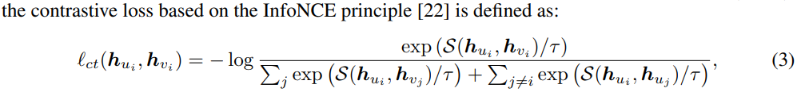
Introduction to GCL
Now we get two sampled Tu and Tv functions and using a GNN encoder we get “views”
U = Tu(G), Hu = f(Au, Xu)
V = Tv(G), Hv = f(Av, Xv)
Hu and Hv are partially incomplete/blind, the hope is that we learn some invariant features that come from forcing Hui and Hvi to agree

Slide 5
Why CaliGCL
In our standard approach we make two implicit assumptions:
Inner product can faithfully produce the similarity in two node representation
Counterpart nodes across two views will always be a positive pair
There are 2 biases in these assumptions:
Similarity estimation bias : Inner Product is not sufficient
Semantic Shift Bias : Same node can flip semantically across views

Slide 6
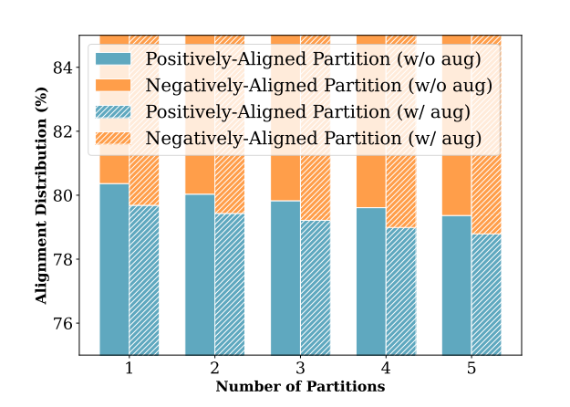
Biases
A +ve pair may have components that internally have -ve product and can reduce the overall +ve value.
the probability that some subset/partition m having -ve product is:
P = CDF( -Mu^2 / sqrt(m).(u^2 + 2.σ^2)^2) -> this is never zero
where the feature distribution is N(u,σ^2)
When nodes are augmented, it is possible that the same node across views ends up with very different semantics when augmented randomly.
This is especially true for nodes on the bridges of communities.
Thus nodes that are ideally a +ve pair, ends up with signaling -ve semantics and worsen our encoder loss.

Slide 7
Solution
To address our problems we use two components:
Exponential Partition (Bias 1)
Dynamic Discriminator (Bias 2)
Exponential Partition:
Designed to exponentiate the inner product of partitions of representation vector such that the positive values remain high but the negative values should decrease.
Dynamic Discriminator:
Use a fusion vector of two node representations (this time in the form of concatenation of augmentation and eigenvectors) and pass it to an MLP for decision making

Slide 8
Exponential Partition
Given representation Hvi, we can take K partitions with m elements each:
Hvi = [ Hvi (1) | Hvi (2) | — — — | Hvi (k) ]
Spart(Hvi, Hvj) = 1/K SUM(k) { exp(kHvi (k) T . Hvj (k) / t) }
Spart(Hvi, Hvj) will always be greater than or equal to S(Hvi, Hvj)

Slide 9
Dynamic Discriminator
L = D^-½. A’. D^-½ where A’ = A + I
L = UλU^T
Create Vector C = Top T eigenvectors of L
Zv = Hv | Cv
Fusion vector = Zi⊙Zj
P(i,j) = D(Zi ⊙ Zj )
Decision boundary:
l(i,j) = 1, if P(i,j) ≥ η
0, if P(i,j) < η

Slide 10
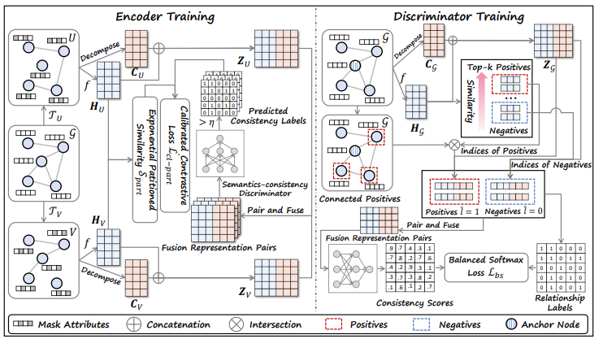
Training

Slide 11
Training
Since the encoder and discriminator both require each other to work well for training themselves we follow a two step process:
Pretraining independently: The encoder is trained with the partitioned contrastive loss. The discriminator is trained on the conservative +ve/-ve pairs. Both components develop some baseline competence without relying on each other.
Alternating Fine-tuning: First the discriminator is used to score all augmented pairs and the encoder is updated. Then the encoder's updated representations are used to re-run k-NN in representation space, and the discriminator is updated..

Slide 12
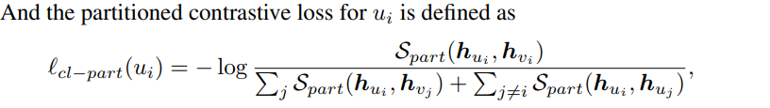
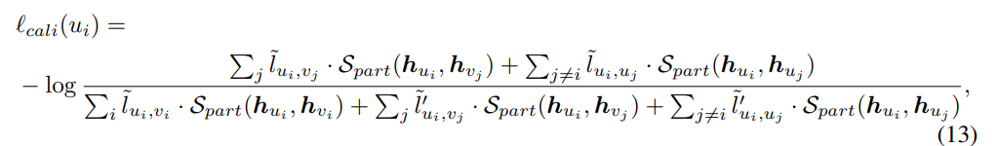
Pre Training vs Fine Tuning Loss
Pre Training:
Fine Tuning:

Slide 13
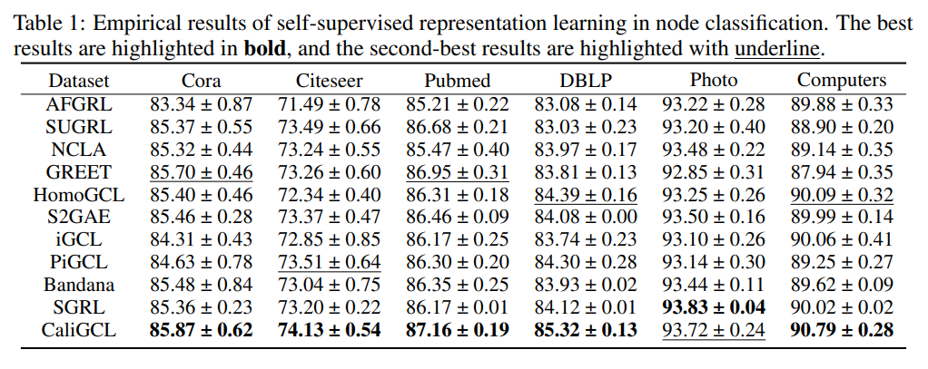
Results

Slide 14
Limitations and Our Idea
Limitation: CaliGCL addresses bias in the contrastive objective but applies its calibration uniformly regardless of graph properties. In heterophilic graphs, where topology and node attributes systematically disagree, CaliGCL's positive label strategy becomes unreliable because it assumes that graph connectivity is a meaningful signal for semantic similarity
Idea: GCL methods including CaliGCL treat all graphs the same way regardless of whether the graph is homophilic or heterophilic. We argue that the right training strategy should depend on how much the graph's topology and node attributes conflict with each other.
Based on this we aim to define a conflict metric and an adaptive regularization weight mechanic

Slide 15
Conflict Metric
For every node pair (i, j):
Structural similarity Ssᵢⱼ — if they are connected, Sˢᵢⱼ = 1, otherwise 0
Attribute similarity Saᵢⱼ — cosine similarity between their raw feature vectors xᵢ and xⱼ:
Saᵢⱼ = xᵢᵀxⱼ / (‖xᵢ‖ · ‖xⱼ‖)
Conflict index C:
C = (1 / |K|) Σ₍ᵢ,ⱼ₎ ∈ K |Ssᵢⱼ − Saᵢⱼ|
where K is a set of sampled pairs to avoid O(N²) computation
C near 0 means the graph is homophilic, near 1 means the graph is heterophilic

Slide 16
Loss
Combined loss has two terms:
Ltotal = (1 − λ(C)) · Lstructural + λ(C) · Lsemantic
Lstructural is the standard GCL contrastive loss using augmented views
Lsemantic is the attribute-based soft contrastive signal
λ(C) = σ(α · (C − β))
each pair (i, j) gets a soft target weight wᵢⱼ = Saᵢⱼ — their attribute cosine similarity. The loss then becomes:
Lsemantic = −Σᵢ Σⱼ wᵢⱼ · log [ exp(Spart(hᵢ, hⱼ) / τ) / Σₖ exp(Spart(hᵢ, hₖ) / τ) ]

Slide 17
Evaluation
Primary metric: Node classification accuracy under linear evaluation, same protocol as CaliGCL. Train the encoder unsupervised, freeze it, train a linear classifier on 10% of nodes, test on the rest.
The key Hypothesis: As C increases (more heterophilic), our model improves over CaliGCL by a larger margin, because the adaptive mechanism specifically helps when topology and attributes conflict. CaliGCL applies the same strategy regardless of C. On Cora where C is low, results should be roughly comparable. On Chameleon and Actor where C is high, our model should pull ahead.

Slide 18
Thank You

